Slide 1
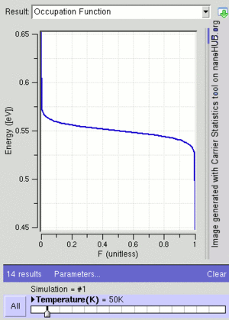
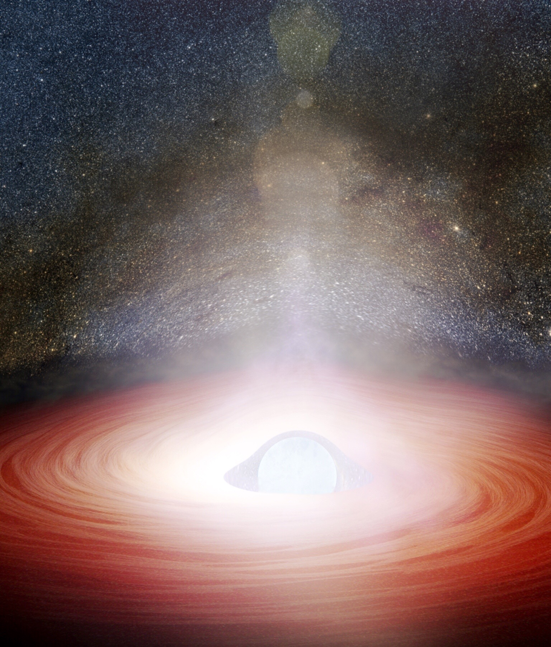
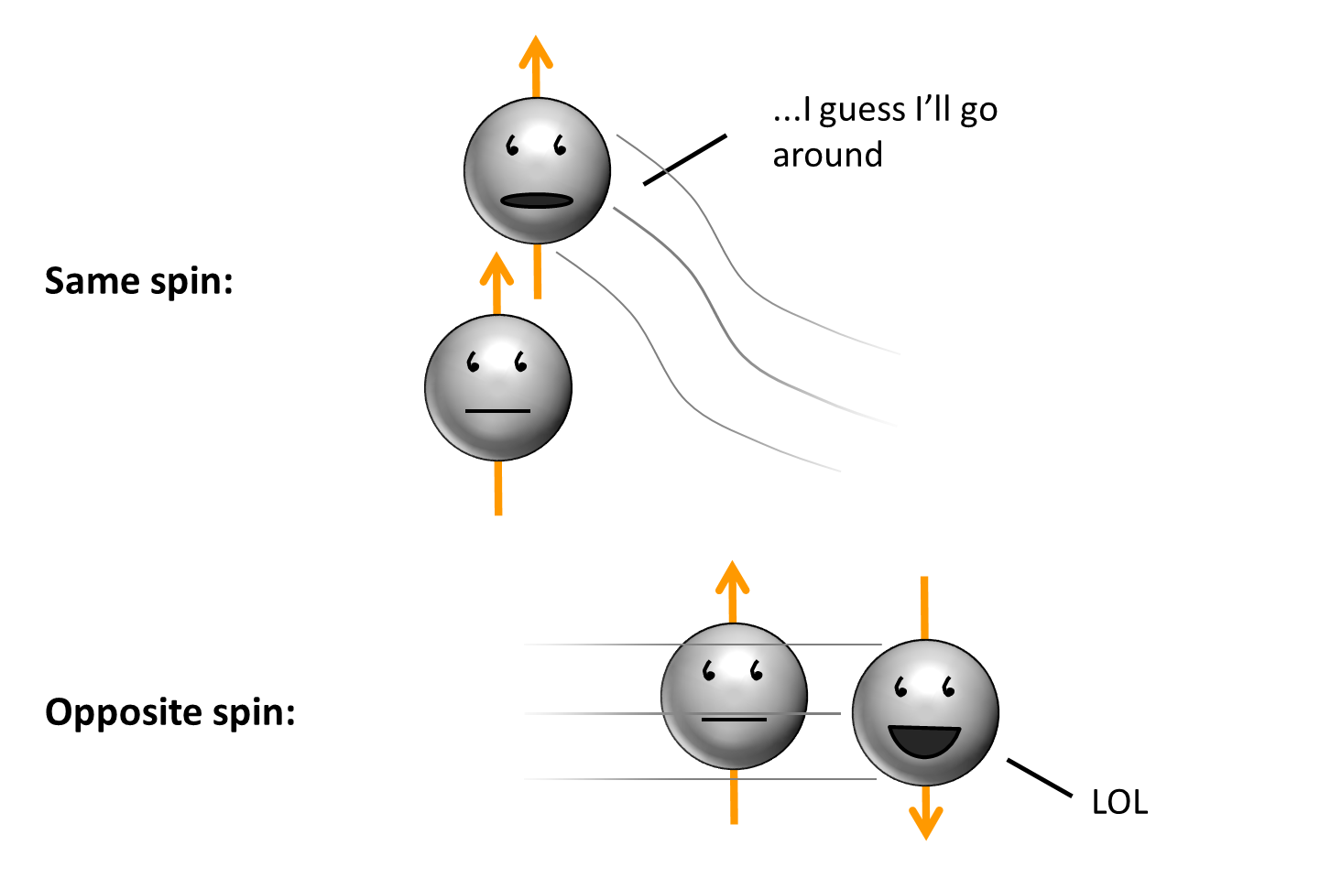
热物（第九周）
费米简并气体的基本性质

Slide 2
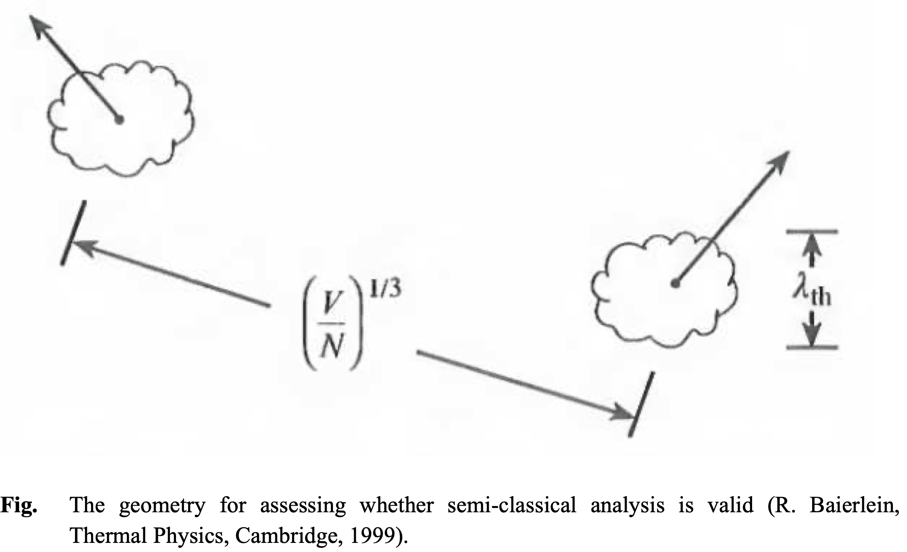
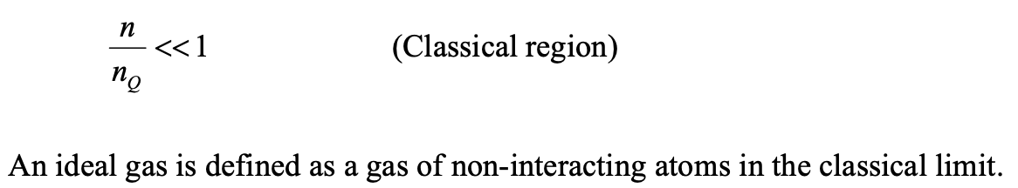

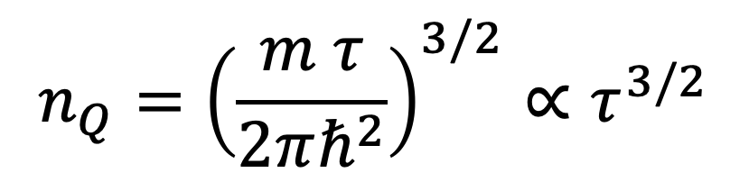
Quantum concentration
$$n_{Q}={\left(\frac{m τ}{2πℏ^{2}}\right)}^{3/2}∝τ^{3/2}$$
$$V_{Q}=\frac{1}{n_{Q}}$$

Slide 3
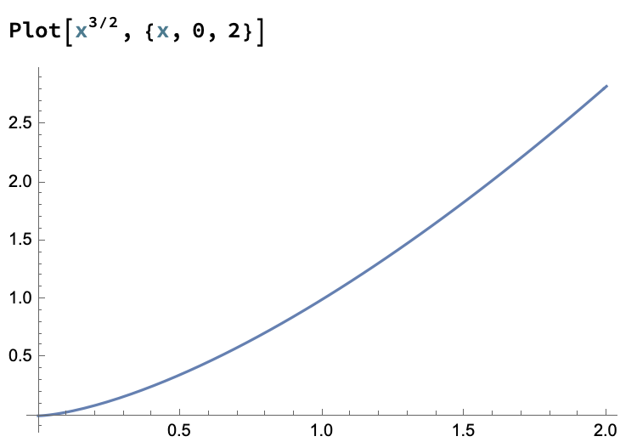

$$n_{Q}∝ τ^{3/2}$$
n
量子
经典
tau

Slide 4
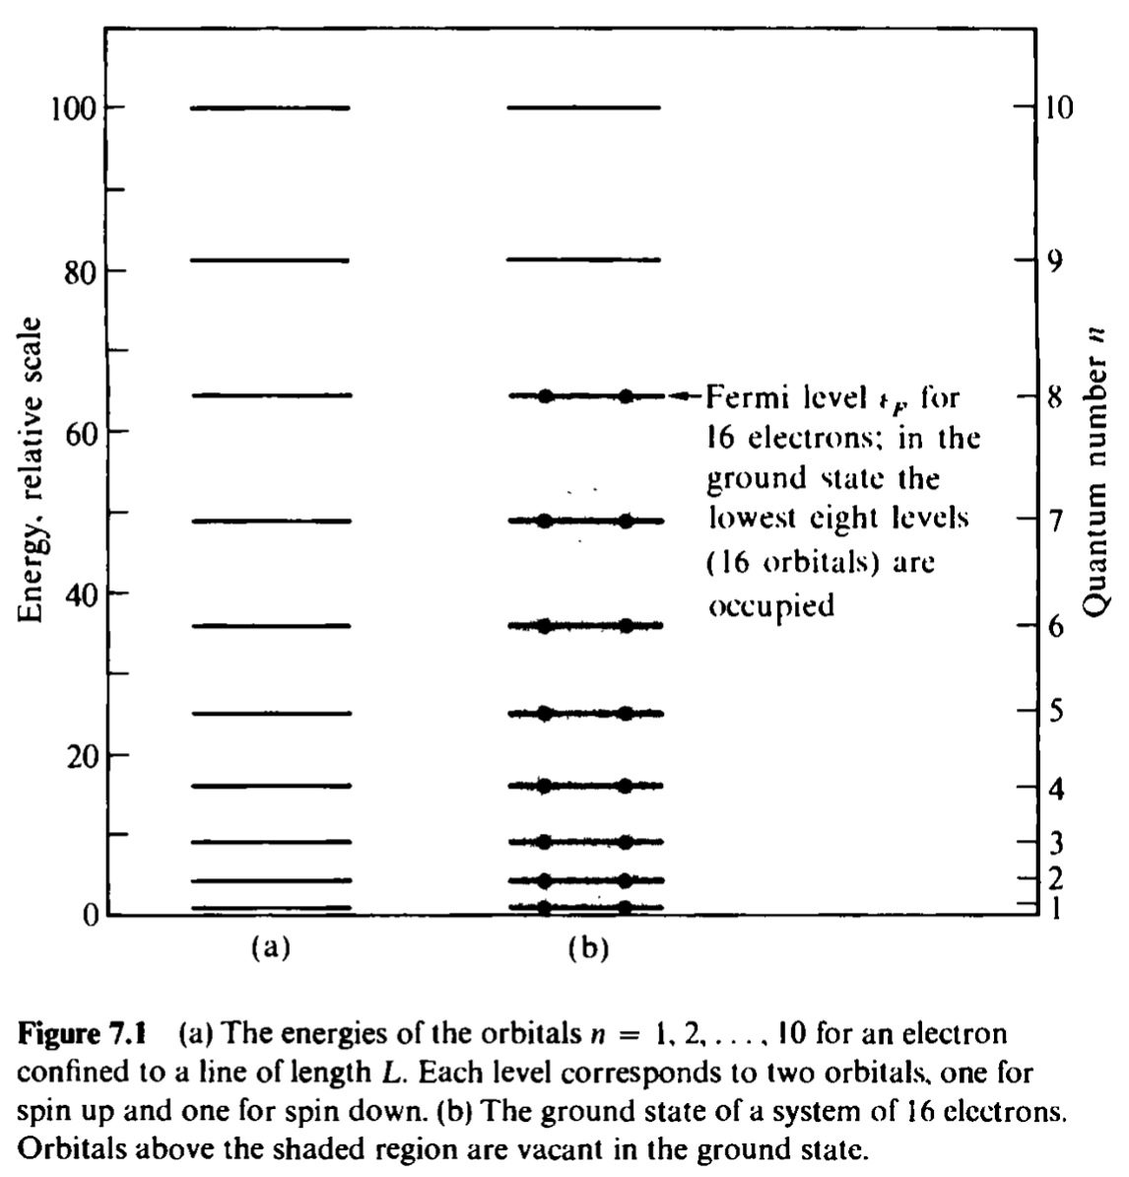


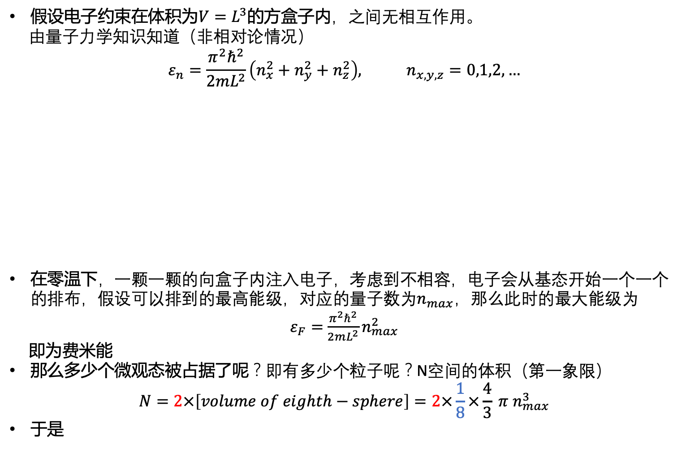


电子气体的费米能
假设电子约束在体积为$V=L^{3}$的方盒子内，之间无相互作用。
由量子力学知识知道（非相对论情况）
$$ε_{n}=\frac{π^{2}ℏ^{2}}{2mL^{2}}\left(n_{x}^{2}+n_{y}^{2}+n_{z}^{2}\right), n_{x,y,z}=0,1,2,…$$
在零温下，一颗一颗的向盒子内注入电子，考虑到不相容，电子会从基态开始一个一个的排布，假设可以排到的最高能级，对应的量子数为$n_{max}$，那么此时的最大能级为
$ε_{F}=$ $\frac{π^{2}ℏ^{2}}{2mL^{2}}n_{max}^{2}$
即为费米能
那么多少个微观态被占据了呢？即有多少个粒子呢？N空间的体积（第一象限）
$$N=2×\left[volume of eighth−sphere\right]=2×\frac{1}{8}×\frac{4}{3} π n_{max}^{3}$$
于是
$$n_{z}$$
$$n_{y}$$
$$n_{x}$$
$$spin factor:2s+1$$

Slide 5
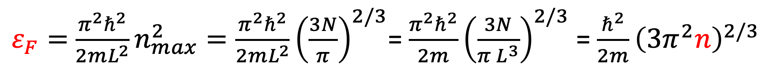
$$n_{max}={\left(\frac{3N}{π}\right)}^{1/3}$$
$ε_{F}=$ $\frac{π^{2}ℏ^{2}}{2mL^{2}}n_{max}^{2}=\frac{π^{2}ℏ^{2}}{2mL^{2}}{\left(\frac{3N}{π}\right)}^{2/3}$= $\frac{π^{2}ℏ^{2}}{2m}{\left(\frac{3N}{π L^{3}}\right)}^{2/3}$ = $\frac{ℏ^{2}}{2m}{\left(3π^{2}n\right)}^{2/3}$
At absolute zero all orbitals with $0<ε<ε_{F}$ will be occupied with f=1. Here $ε_{F}$ is the energy below which there are just enough orbitals to hod the number of particles assigned to the system. Above $ε_{F}$ all orbitals will have f=0 at tau=0.

Slide 6
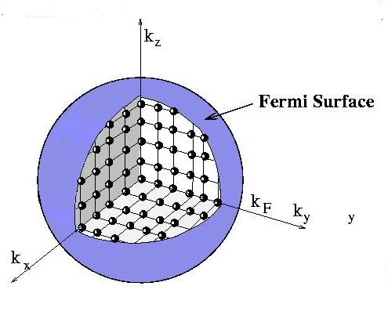



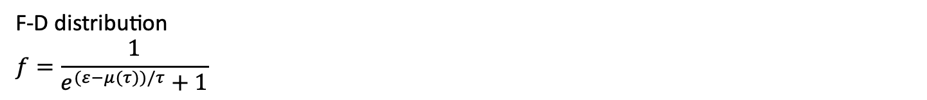



观测FD分布函数
$$ε<μ(0)$$
$$f→1$$
F-D distribution
$$f=\frac{1}{e^{(ε−μ(τ))/τ}+1}$$
$$τ→0$$
$$ε>μ(0)$$
$$f→0$$
$$μ\left(0\right)=ε_{F}$$

Slide 7
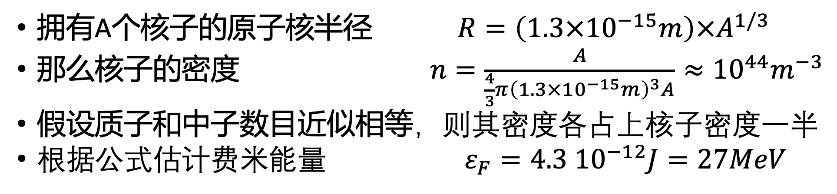
The Fermi Gas of Nucleons in a Nucleus
拥有A个核子的原子核半径 $R=\left(1.3×{10}^{−15}m\right)×A^{1/3}$
那么核子的密度 $n=\frac{A}{\frac{4}{3}π{\left(1.3×{10}^{−15}m\right)}^{3}A}≈{10}^{44}m^{−3}$
假设质子和中子数目近似相等，则其密度各占上核子密度一半
根据公式估计费米能量 $ε_{F}=4.3 {10}^{−12}J=27MeV$

Slide 8
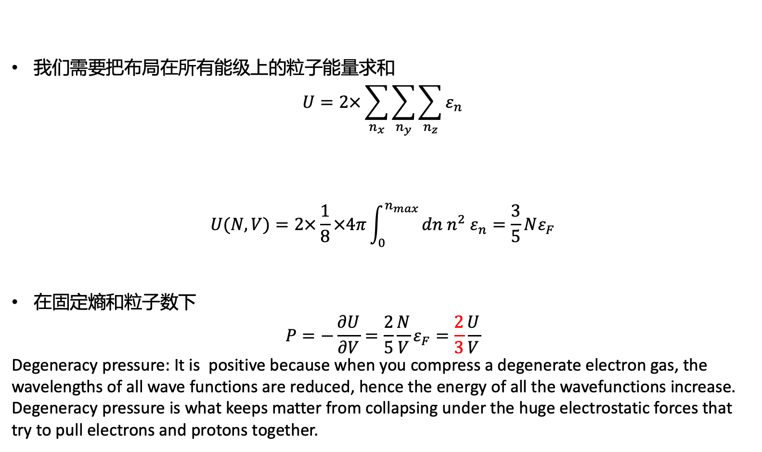
零温下电子气体的总能量
我们需要把布局在所有能级上的粒子能量求和
$$U=2×\sum_{n_{x}}{\sum_{n_{y}}{\sum_{n_{z}}{ε_{n}}}}$$
$$U(N,V)=2×\frac{1}{8}×4π\int_{0}^{n_{max}}{dn n^{2} ε_{n}=\frac{3}{5}Nε_{F}}$$
在固定熵和粒子数下
$$P=−\frac{∂U}{∂V}=\frac{2}{5}\frac{N}{V}ε_{F}=\frac{2}{3}\frac{U}{V}$$
Degeneracy pressure: It is positive because when you compress a degenerate electron gas, the wavelengths of all wave functions are reduced, hence the energy of all the wavefunctions increase. Degeneracy pressure is what keeps matter from collapsing under the huge electrostatic forces that try to pull electrons and protons together.
零温下电子气体的压强

Slide 9
The Fermi energy is the highest single-particle energy that a system of electrons at absolute zero temperature will occupy.
It is normally a very high energy
The average energy per electron for a free-electron gas is 60% of the Fermi energy

Slide 10
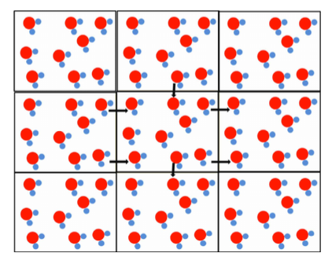
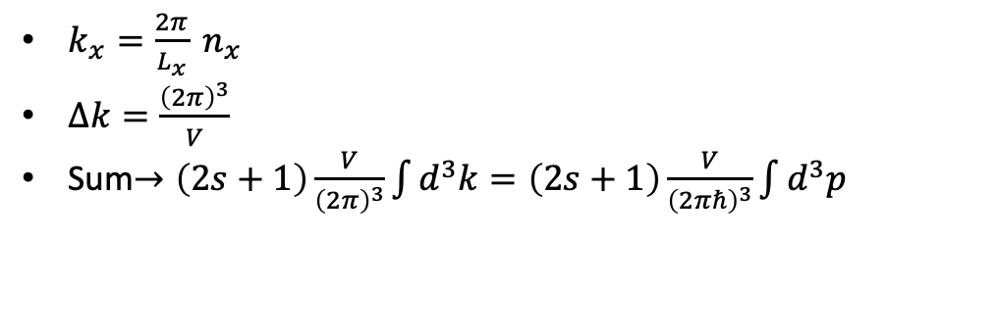
另外一种打开方式
Wavefunctions in a box
$k_{x}=\frac{2π}{L_{x}} n_{x}$
$∆k=\frac{{\left(2π\right)}^{3}}{V}$
Sum$→\left(2s+1\right)\frac{V}{{\left(2π\right)}^{3}}\int{d^{3}k=\left(2s+1\right)\frac{V}{{\left(2πℏ\right)}^{3}}\int{d^{3}p}}$

Slide 11
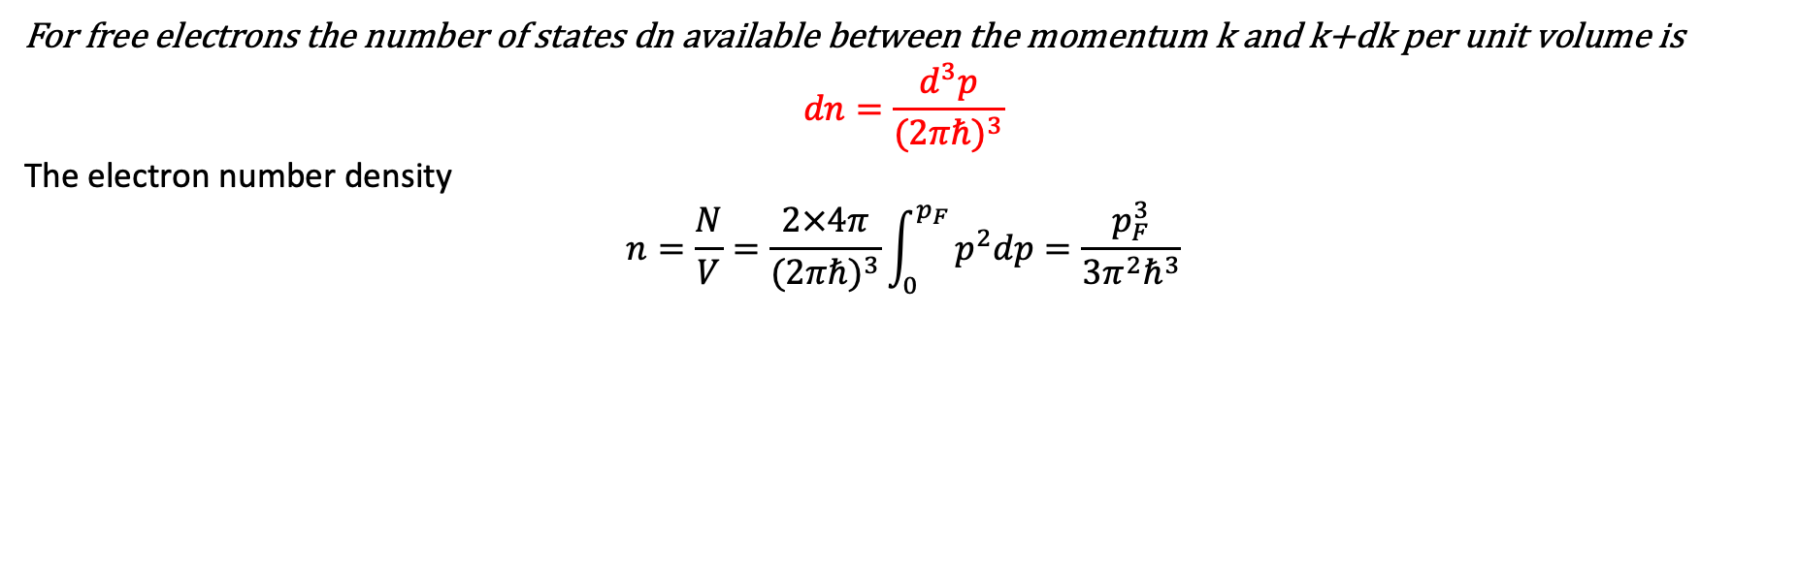

另外一种打开方式
For free electrons the number of states dn available between the momentum k and k+dk per unit volume is
$$dn=\frac{d^{3}p}{{(2πℏ)}^{3}}$$
The electron number density
$$n=\frac{N}{V}=\frac{2×4π}{{(2πℏ)}^{3}}\int_{0}^{p_{F}}{p^{2}dp=\frac{p_{F}^{3}}{3π^{2}ℏ^{3}}}$$
$$p_{F}=ℏ{\left(3π^{2}\frac{N}{V}\right)}^{1/3}$$
费米动量
$ε_{F}=$ $\frac{ℏ^{2}}{2m}{\left(3π^{2}n\right)}^{2/3}⇔\frac{p_{F}^{2}}{2m}$
费米速度 $v_{F}=\frac{k_{F}}{m}$, The electrons at the Fermi level are moving at a very high velocity, 相对论or非？

Slide 12
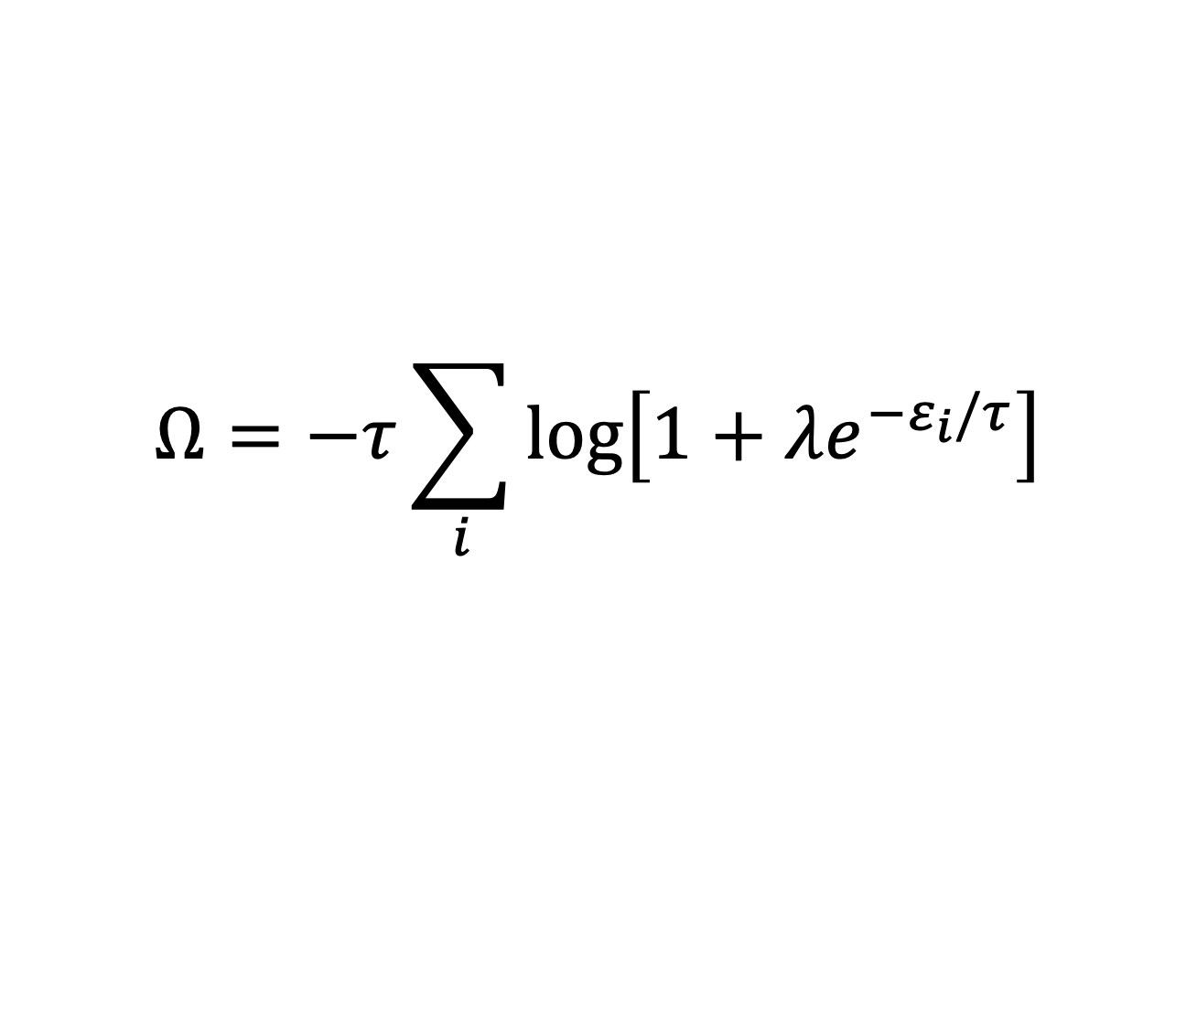
另外一种打开方式（再一般些！）
Grand canonical potential
$$Ω=−τ\sum_{i}{\log\left[1+λe^{−ε_{i}/τ}\right]}$$

Slide 13

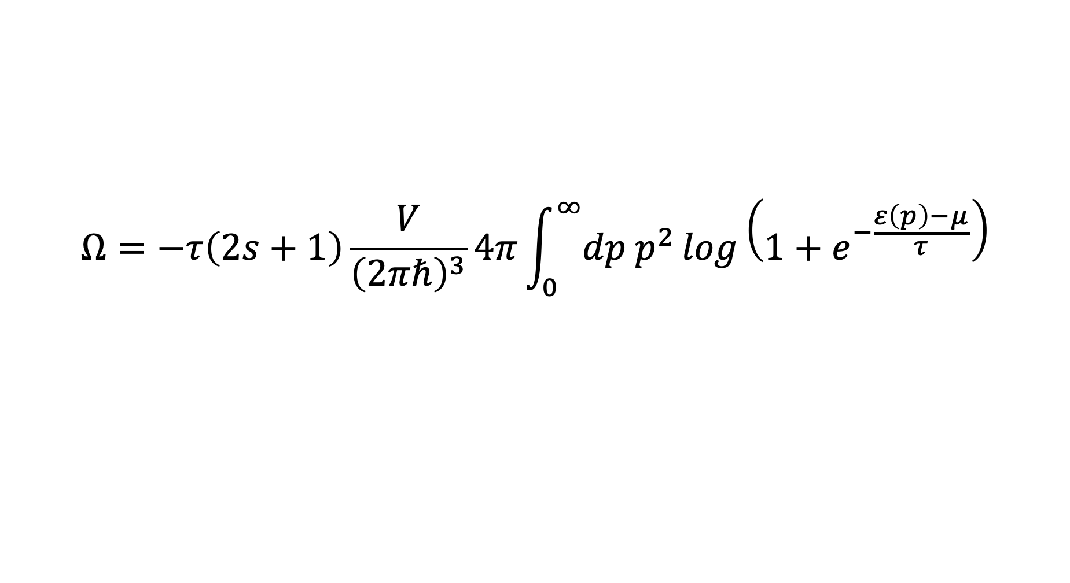
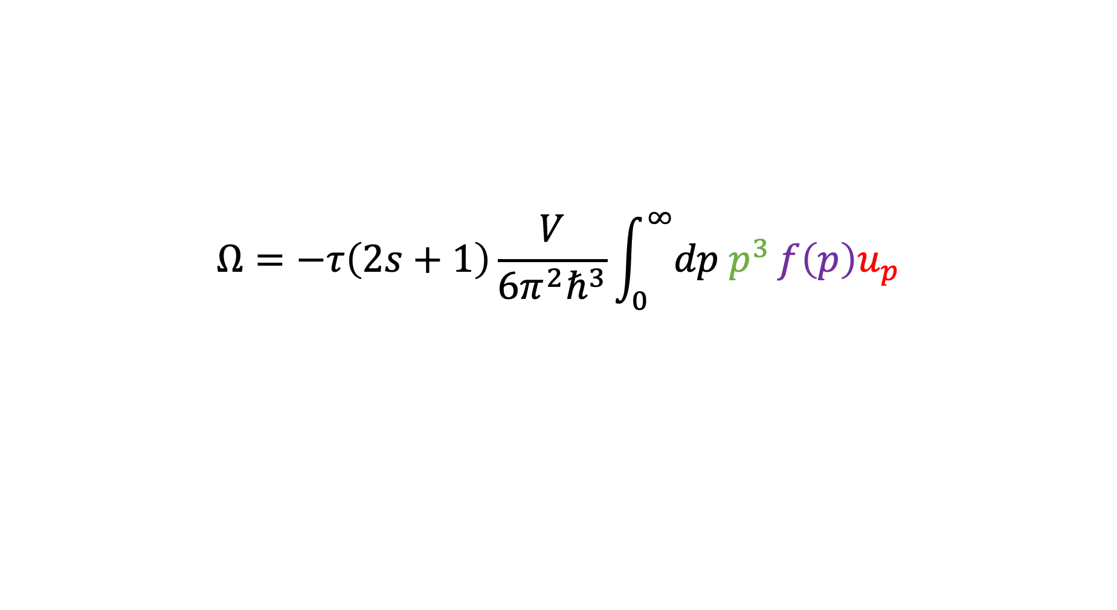
$$Ω=−τ\left(2s+1\right)\frac{V}{{\left(2πℏ\right)}^{3}}4π\int_{0}^{∞}{dp p^{2}}log\left(1+e^{−\frac{ε\left(p\right)−μ}{τ}}\right)$$
$$ε\left(p\right)=\sqrt{m^{2}c^{4}+c^{2}p^{2}}$$
$$u_{p}=\frac{∂ε}{∂p}=\frac{p}{m\sqrt{1+\frac{p^{2}}{m^{2}c^{2}}}}$$
$$Ω=−τ\left(2s+1\right)\frac{V}{{6π^{2}ℏ}^{3}}\int_{0}^{∞}{dp p^{3}}f\left(p\right)u_{p}$$

Slide 14
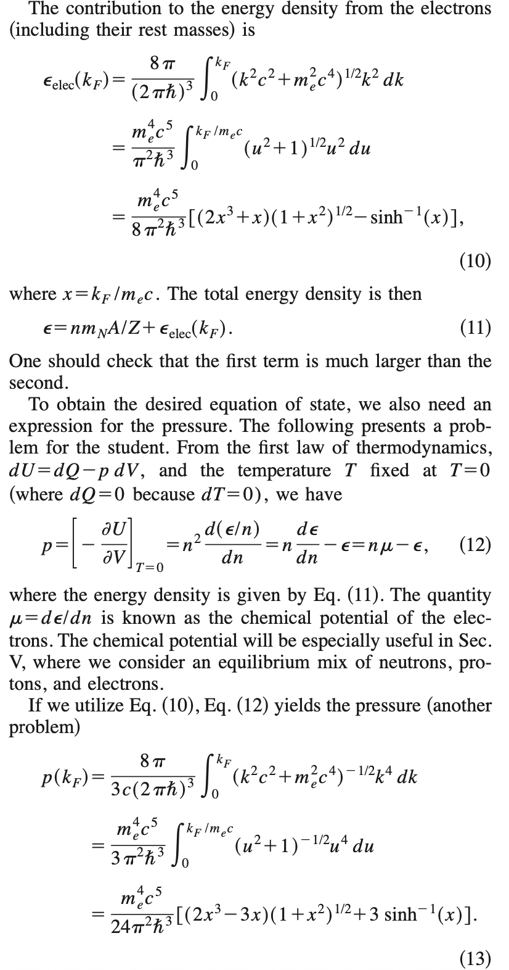
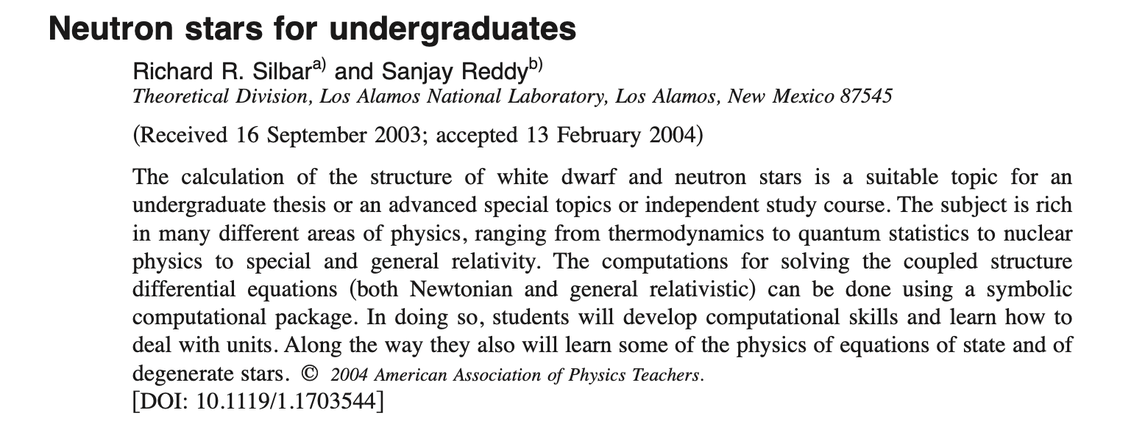
另外一种打开方式

Slide 15
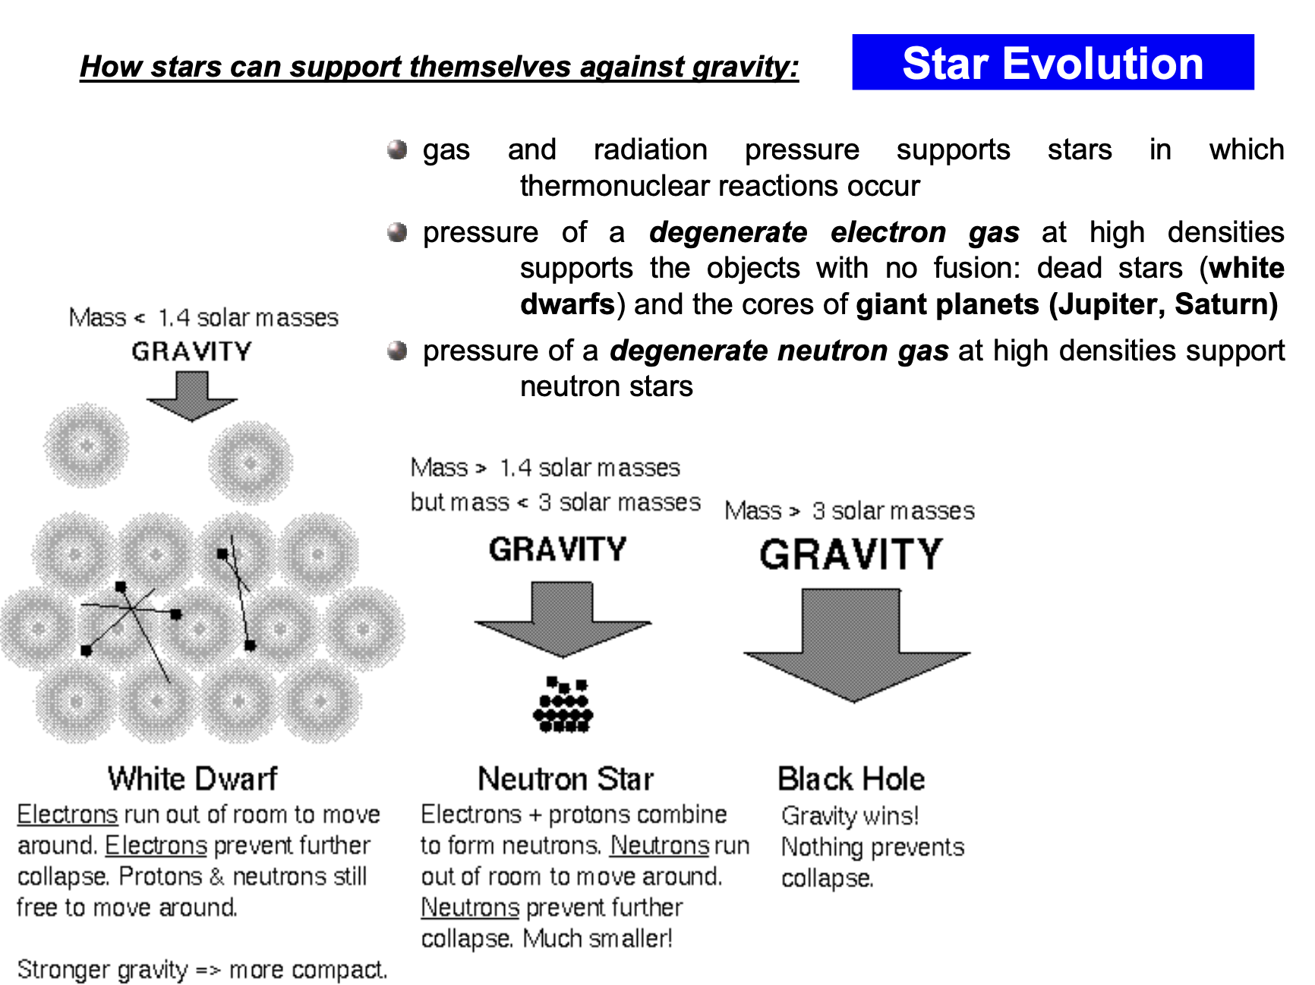

Slide 16
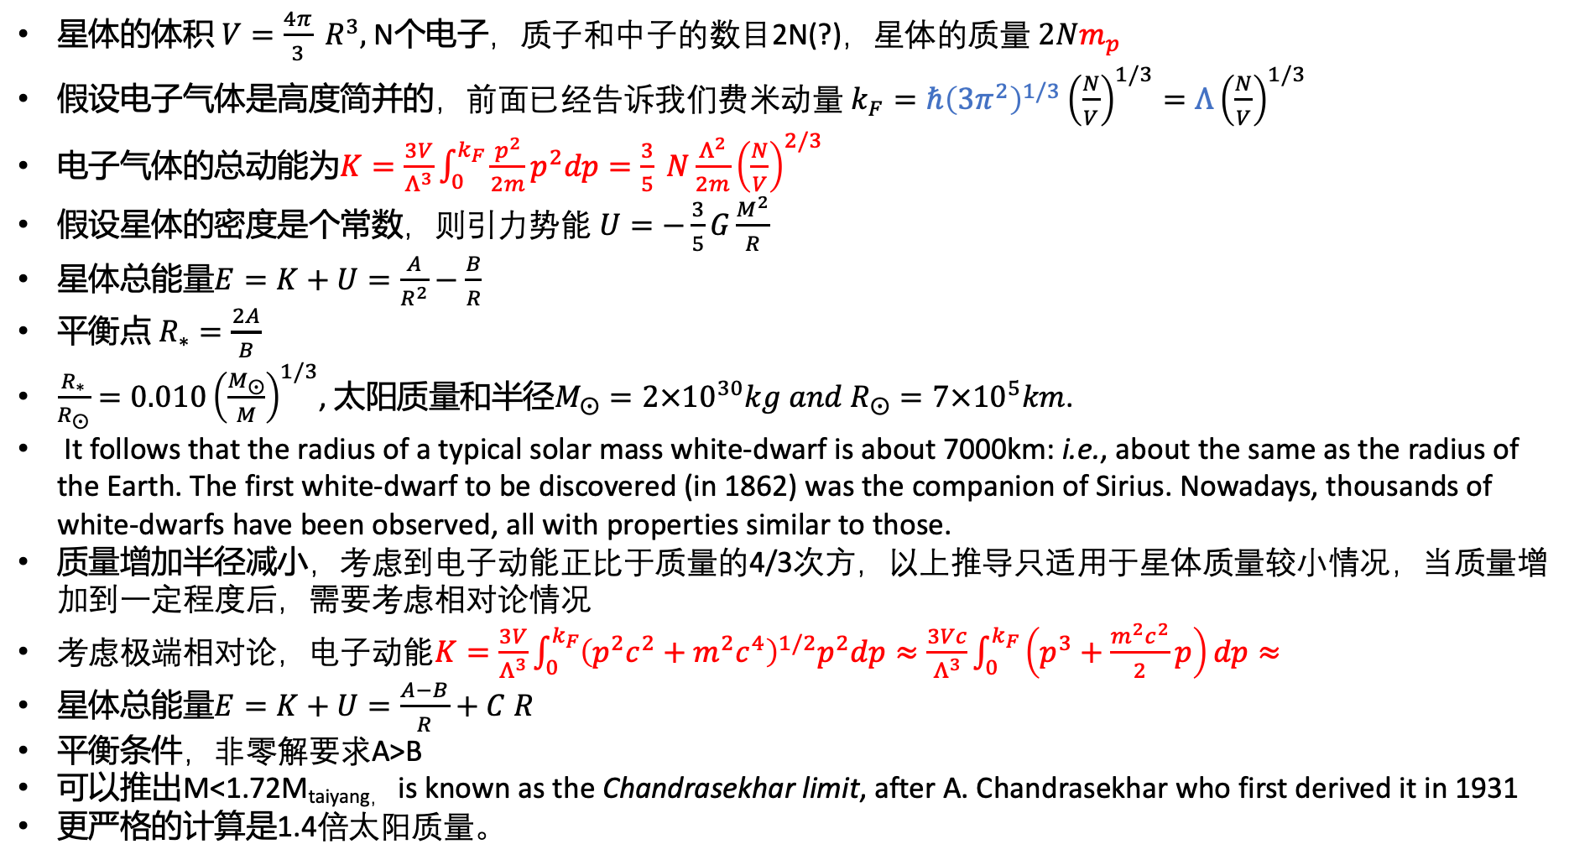
星体的体积 $V=\frac{4π}{3} R^{3},$ N个电子，质子和中子的数目2N(?)，星体的质量 $2Nm_{p}$
假设电子气体是高度简并的，前面已经告诉我们费米动量 $k_{F}=ℏ{\left(3π^{2}\right)}^{1/3}{\left(\frac{N}{V}\right)}^{1/3}={Λ\left(\frac{N}{V}\right)}^{1/3}$
电子气体的总动能为$K=\frac{3V}{Λ^{3}}\int_{0}^{k_{F}}{\frac{p^{2}}{2m}p^{2}dp=\frac{3}{5} N\frac{Λ^{2}}{2m}{\left(\frac{N}{V}\right)}^{2/3}}$
假设星体的密度是个常数，则引力势能 $U=−\frac{3}{5}G\frac{M^{2}}{R}$
星体总能量$E=K+U=\frac{A}{R^{2}}−\frac{B}{R}$
平衡点 $R_{∗}=\frac{2A}{B}$
$\frac{R_{∗}}{R_{⨀}}=0.010{\left(\frac{M_{⨀}}{M}\right)}^{1/3}$, 太阳质量和半径$M_{⨀}=2×{10}^{30}kg and R_{⨀}=7×{10}^{5}km$.
It follows that the radius of a typical solar mass white-dwarf is about 7000km: i.e., about the same as the radius of the Earth. The first white-dwarf to be discovered (in 1862) was the companion of Sirius. Nowadays, thousands of white-dwarfs have been observed, all with properties similar to those.
质量增加半径减小，考虑到电子动能正比于质量的4/3次方，以上推导只适用于星体质量较小情况，当质量增加到一定程度后，需要考虑相对论情况
考虑极端相对论，电子动能$K=\frac{3V}{Λ^{3}}\int_{0}^{k_{F}}{{\left(p^{2}c^{2}+m^{2}c^{4}\right)}^{1/2}p^{2}dp≈\frac{3Vc}{Λ^{3}}\int_{0}^{k_{F}}{\left(p^{3}+\frac{m^{2}c^{2}}{2}p\right)dp}≈}$
星体总能量$E=K+U=\frac{A−B}{R}+C R$
平衡条件，非零解要求A>B
可以推出M<1.72M_{taiyang，} is known as the Chandrasekhar limit, after A. Chandrasekhar who first derived it in 1931
更严格的计算是1.4倍太阳质量。
2022.03.10

Slide 17
有限温
高温极限
低温极限
一般情况

Slide 18

观测FD分布函数
$$ε<μ(0)$$
$$f→1$$
F-D distribution
$$f=\frac{1}{e^{(ε−μ(τ))/τ}+1}$$
$$τ→0$$
$$ε>μ(0)$$
$$f→0$$
$$μ\left(0\right)=ε_{F}=τ_{F}$$

Slide 19
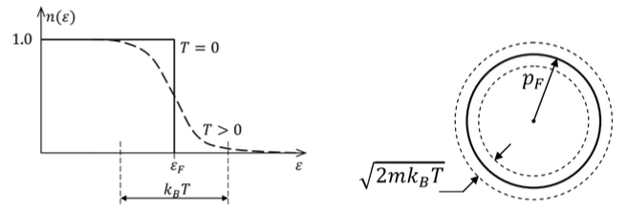
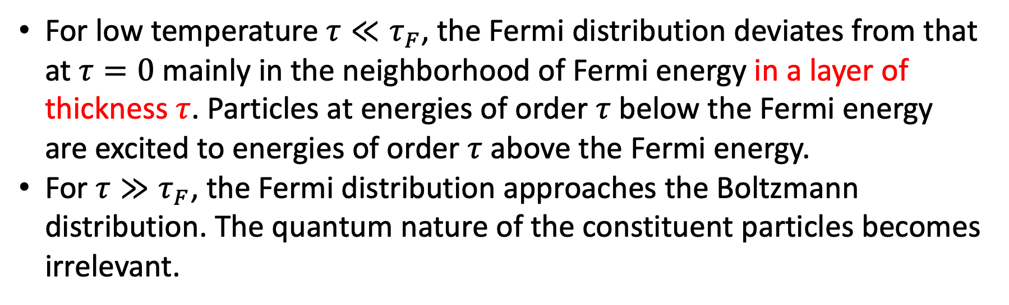
Fermi temperature
For low temperature $τ≪τ_{F}$, the Fermi distribution deviates from that at $τ=0$ mainly in the neighborhood of Fermi energy in a layer of thickness $τ$. Particles at energies of order $τ$ below the Fermi energy are excited to energies of order $τ$ above the Fermi energy.
For $τ≫τ_{F}$, the Fermi distribution approaches the Boltzmann distribution. The quantum nature of the constituent particles becomes irrelevant.

Slide 20
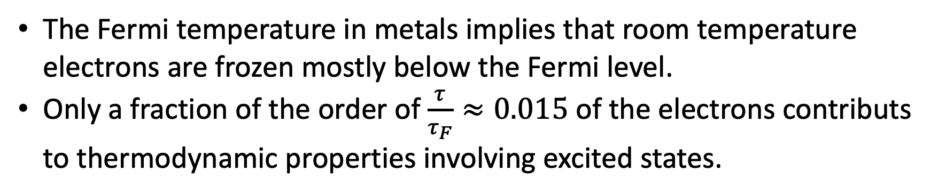
Frozen vs. active electrons
The Fermi temperature in metals implies that room temperature electrons are frozen mostly below the Fermi level.
Only a fraction of the order of $\frac{τ}{τ_{F}}≈0.015$ of the electrons contributs to thermodynamic properties involving excited states.

Slide 21
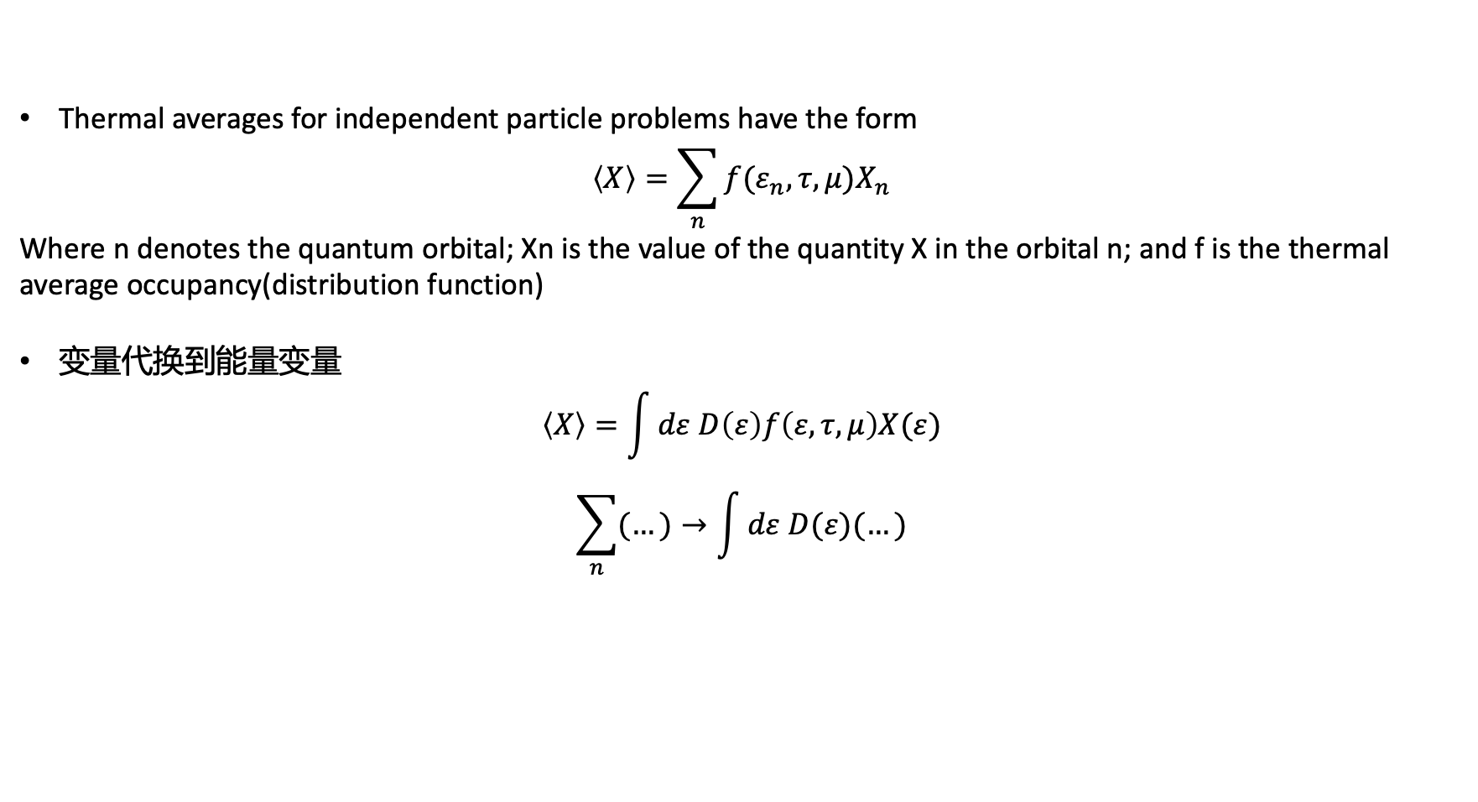

Thermal averages for independent particle problems have the form
$$\left\langle X\right\rangle =\sum_{n}{f(ε_{n},τ,μ)X_{n}}$$
Where n denotes the quantum orbital; Xn is the value of the quantity X in the orbital n; and f is the thermal average occupancy(distribution function)
变量代换到能量变量
$$\left\langle X\right\rangle =\int{dε D\left(ε\right)f\left(ε,τ,μ\right)X(ε)}$$
$$\sum_{n}{(…)→\int{dε D(ε)(…)}}$$
The density of states (the number of single-particle’s state per unit energy)
$$D\left(ε\right)=\frac{dN}{dε}$$

Slide 22
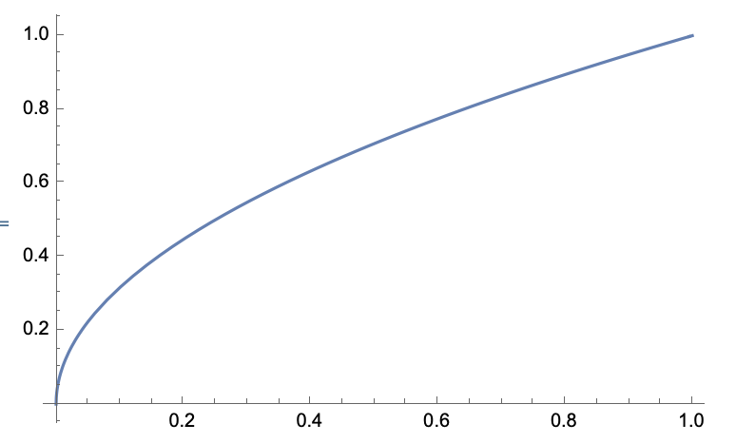
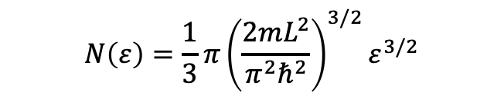
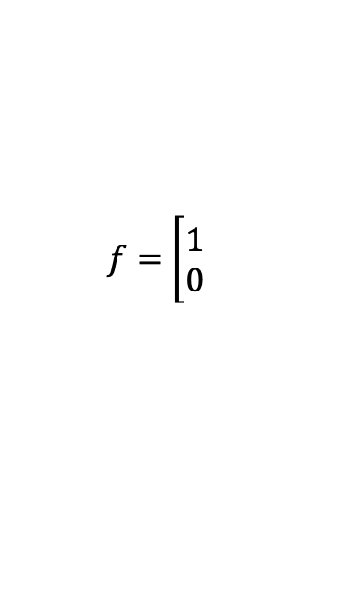
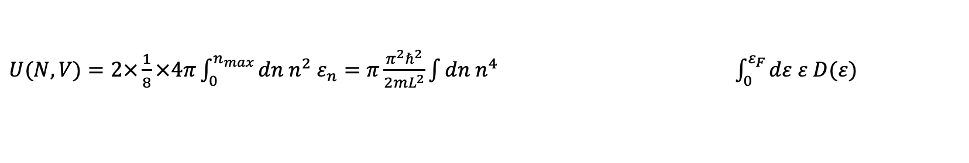
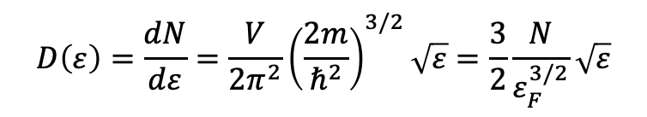
For example, $ε=$ $\frac{π^{2}ℏ^{2}}{2mL^{2}}n^{2} →n={\left(\frac{2mL^{2}}{π^{2}ℏ^{2}}\right)}^{1/2}\sqrt{ε}$
And $N=2×\frac{1}{8}×\frac{4}{3} πn^{3}$
$$N\left(ε\right)=\frac{1}{3}π{\left(\frac{2mL^{2}}{π^{2}ℏ^{2}}\right)}^{3/2}ε^{3/2}$$
$$D\left(ε\right)=\frac{dN}{dε}=\frac{V}{2π^{2}}{\left(\frac{2m}{ℏ^{2}}\right)}^{3/2}\sqrt{ε}=\frac{3}{2}\frac{N}{ε_{F}^{3/2}}\sqrt{ε}$$
$U(N,V)=2×\frac{1}{8}×4π\int_{0}^{n_{max}}{dn n^{2} ε_{n}=π\frac{π^{2}ℏ^{2}}{2mL^{2}}\int{dn n^{4}} }$ $\int_{0}^{ε_{F}}{dε ε D(ε)}$
$$f=\left[\begin{matrix}1 \\ 0\end{matrix}\right.$$

Slide 23
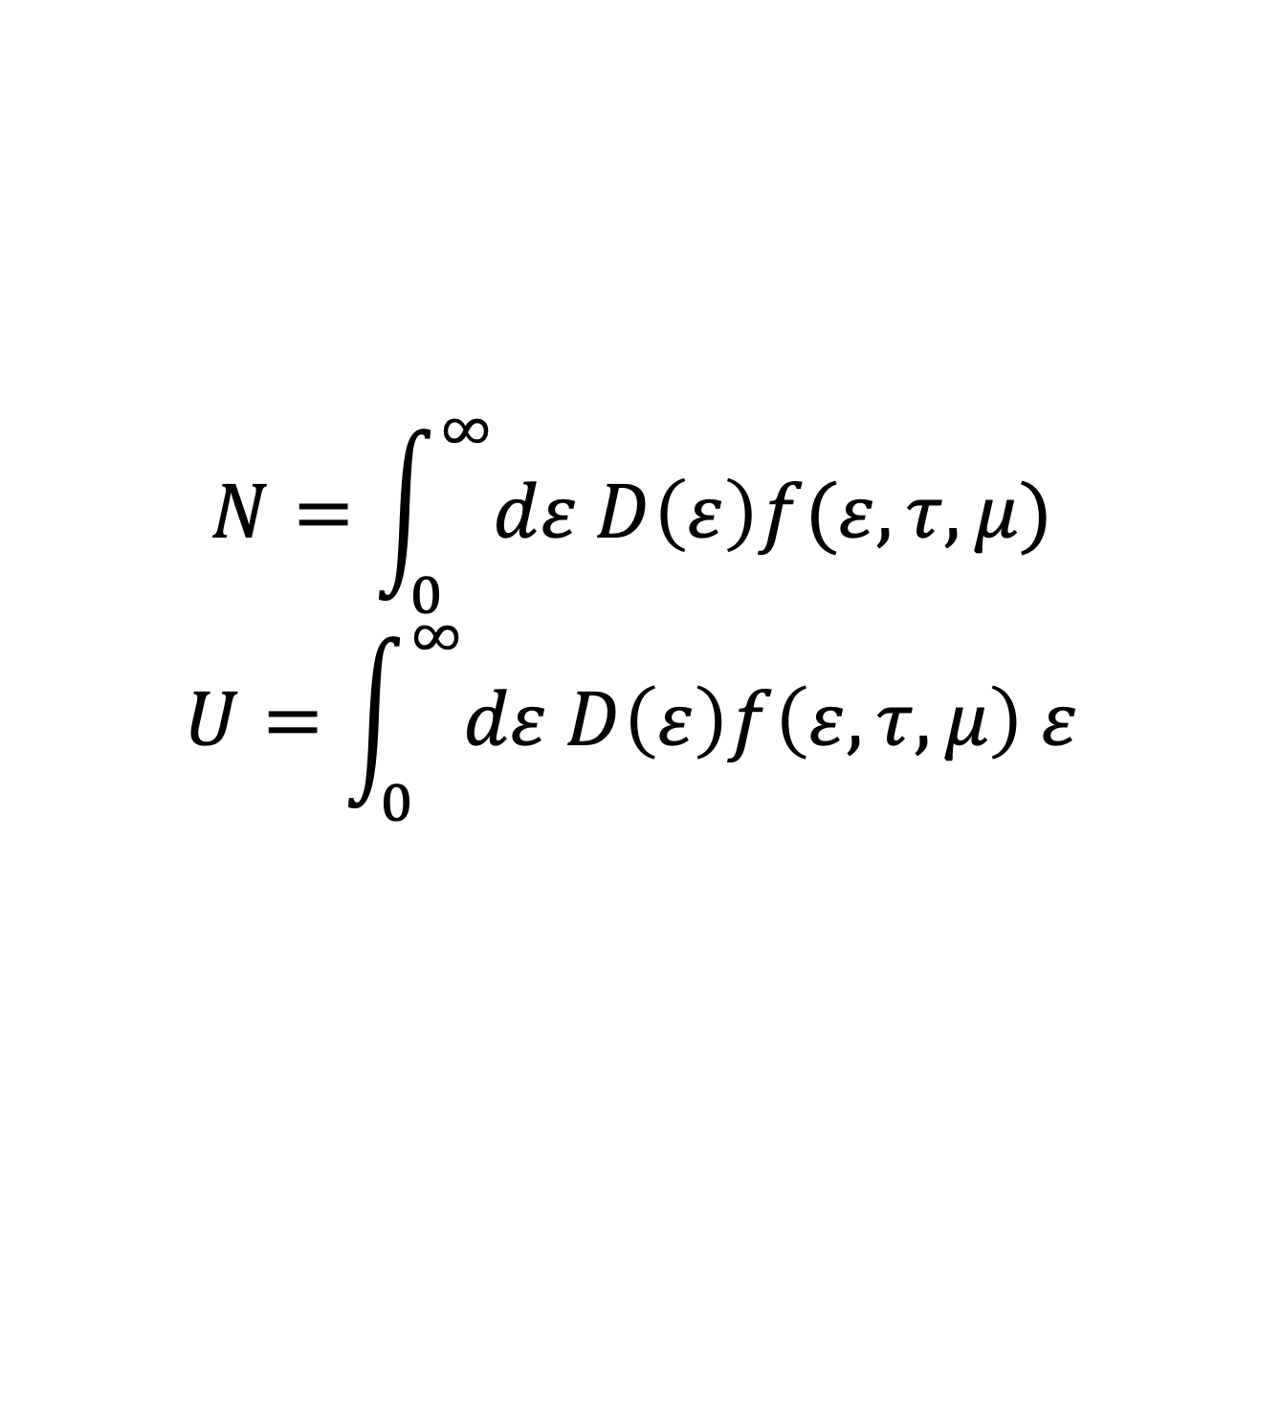
推广到一般温度下
$$N=\int_{0}^{∞}{dε D\left(ε\right)f(ε,τ,μ)}$$
$$U=\int_{0}^{∞}{dε D\left(ε\right)f\left(ε,τ,μ\right) ε}$$
接下来玩玩儿数学

Slide 24
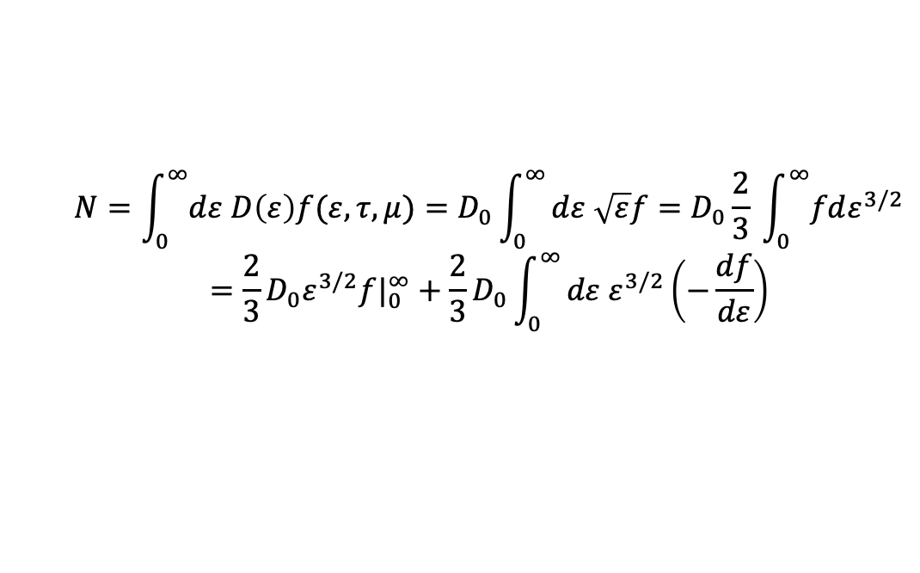
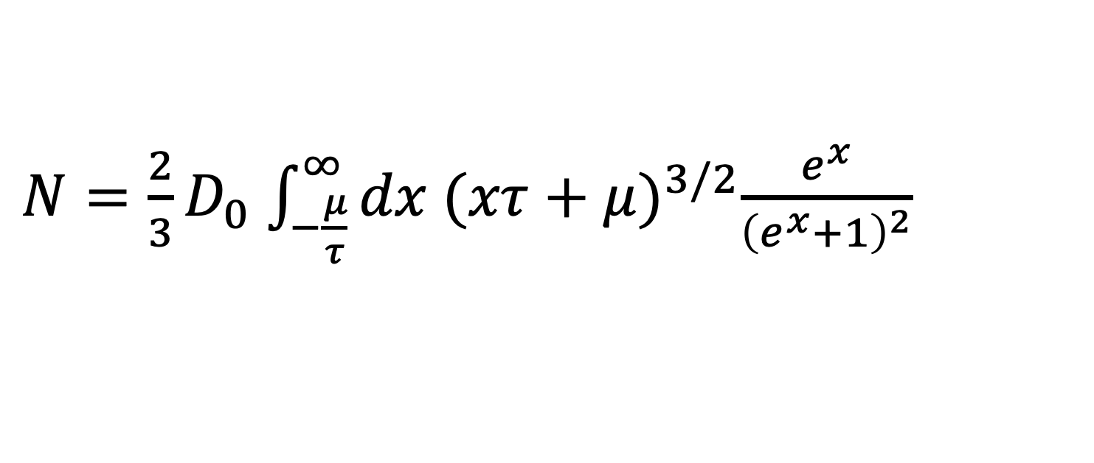
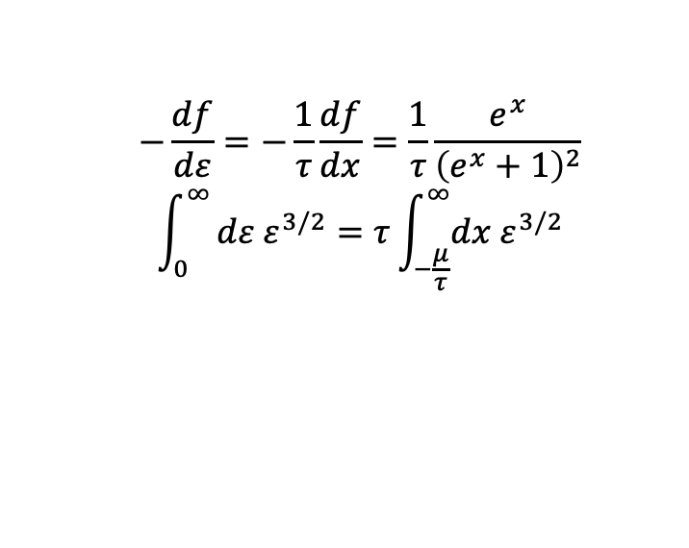

Case-I: $τ≪ε_{F}$
$$N=\int_{0}^{∞}{dε D\left(ε\right)f(ε,τ,μ)}=D_{0}\int_{0}^{∞}{dε \sqrt{ε}f=D_{0}\frac{2}{3} \int_{0}^{∞}{fdε^{3/2}}}$$
$$=\frac{2}{3}D_{0}ε^{3/2}{f|}_{0}^{∞}+\frac{2}{3}D_{0}\int_{0}^{∞}{dε ε^{3/2}\left(−\frac{df}{dε}\right)}$$
Define $x≡\frac{ε−μ}{τ}$
$$−\frac{df}{dε}=−\frac{1}{τ}\frac{df}{dx}=\frac{1}{τ}\frac{e^{x}}{{\left(e^{x}+1\right)}^{2}}$$
$$\int_{0}^{∞}{dε ε^{3/2}=τ\int_{−\frac{μ}{τ}}^{∞}{dx ε^{3/2}}}$$
$N=\frac{2}{3}D_{0}$ $\int_{−\frac{μ}{τ}}^{∞}{dx {(xτ+μ)}^{3/2}\frac{e^{x}}{{\left(e^{x}+1\right)}^{2}}}$

Slide 25
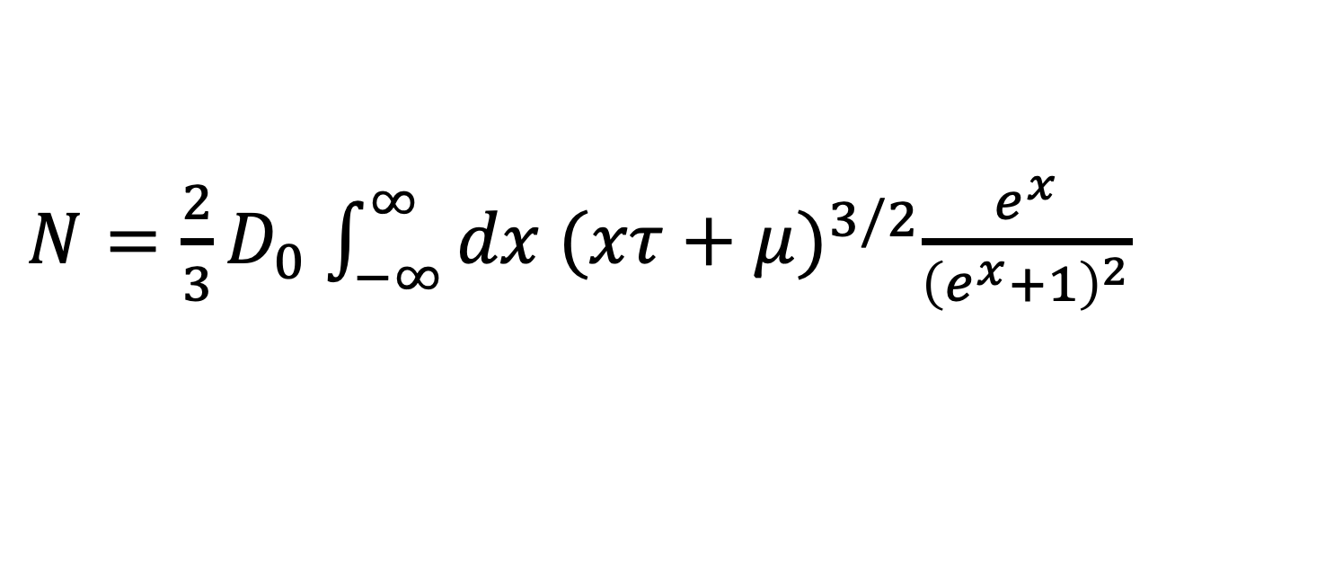
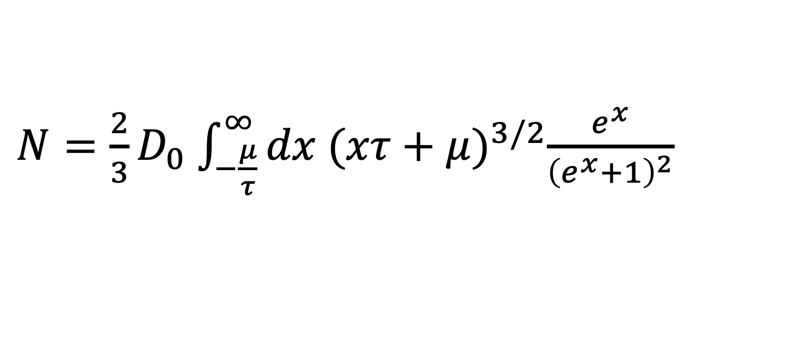

$N=\frac{2}{3}D_{0}$ $\int_{−\frac{μ}{τ}}^{∞}{dx {(xτ+μ)}^{3/2}\frac{e^{x}}{{\left(e^{x}+1\right)}^{2}}}$
$$−\frac{μ}{τ}→−∞$$
$N=\frac{2}{3}D_{0}$ $\int_{−∞}^{∞}{dx {(xτ+μ)}^{3/2}\frac{e^{x}}{{\left(e^{x}+1\right)}^{2}}}$

Slide 26
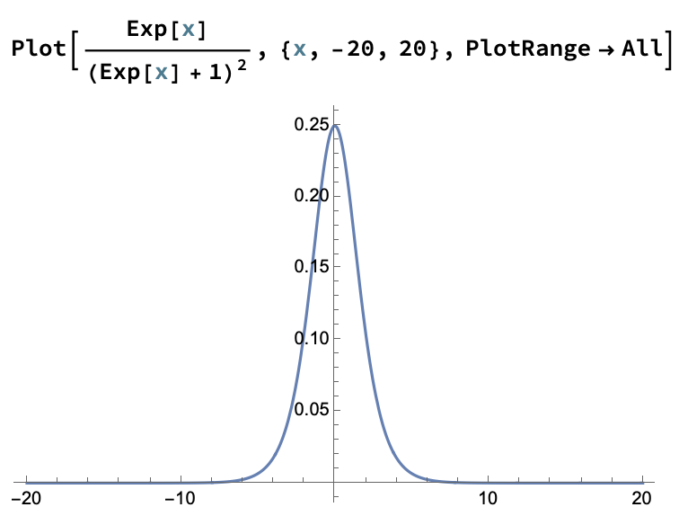

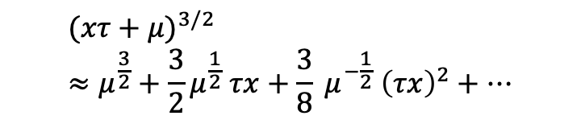
$$\frac{e^{x}}{{\left(e^{x}+1\right)}^{2}}$$
$${(xτ+μ)}^{3/2}≈μ^{\frac{3}{2}}+\frac{3}{2}μ^{\frac{1}{2}} τx+\frac{3}{8} μ^{−\frac{1}{2}} {\left(τx\right)}^{2}+…$$

Slide 27
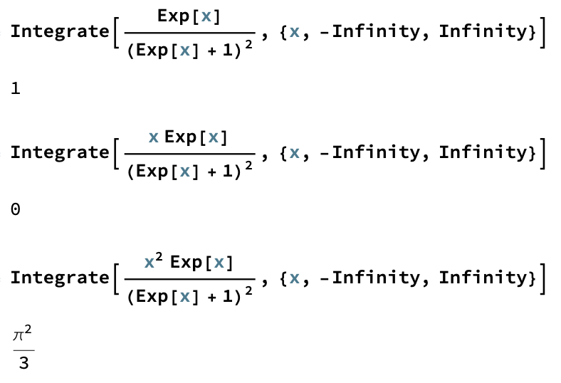
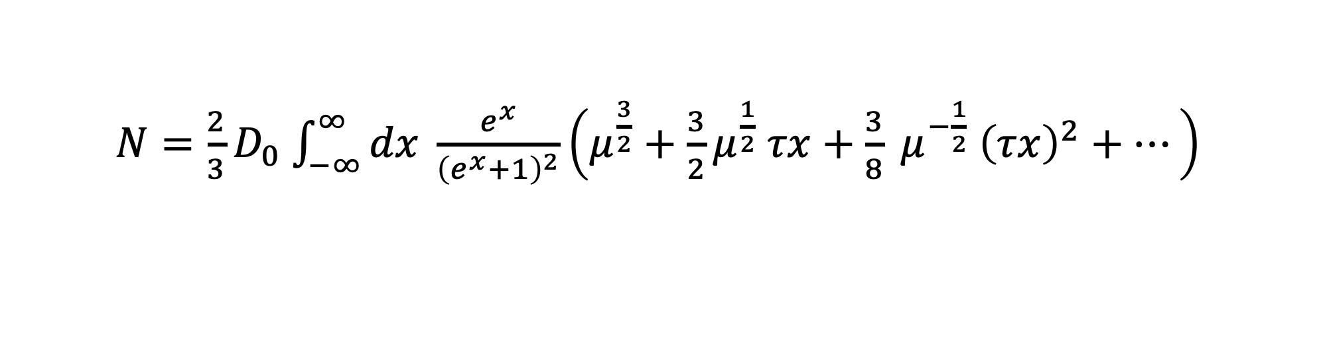
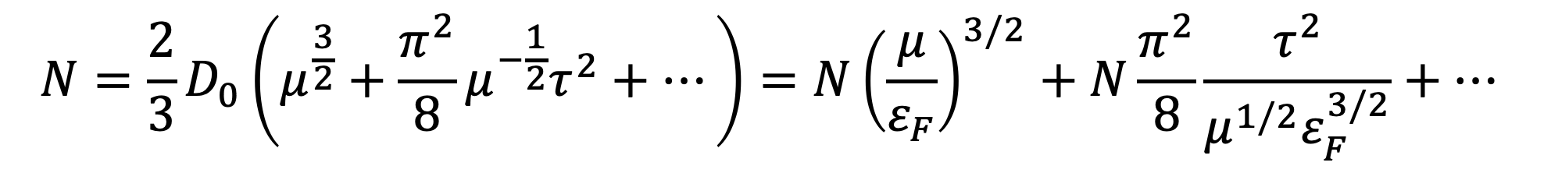
$N=\frac{2}{3}D_{0}$ $\int_{−∞}^{∞}{dx \frac{e^{x}}{{\left(e^{x}+1\right)}^{2}}\left(μ^{\frac{3}{2}}+\frac{3}{2}μ^{\frac{1}{2}} τx+\frac{3}{8} μ^{−\frac{1}{2}} {\left(τx\right)}^{2}+…\right)}$
$$N=\frac{2}{3}D_{0}\left(μ^{\frac{3}{2}}+\frac{π^{2}}{8}μ^{−\frac{1}{2}}τ^{2}+…\right)=N{\left(\frac{μ}{ε_{F}}\right)}^{3/2}+N\frac{π^{2}}{8}\frac{τ^{2}}{μ^{1/2}ε_{F}^{3/2}}+…$$

Slide 28
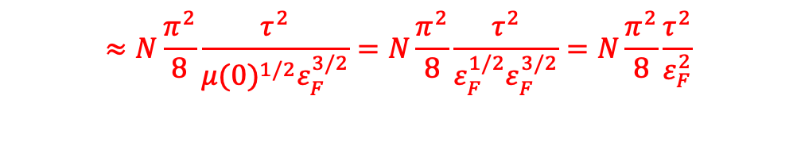
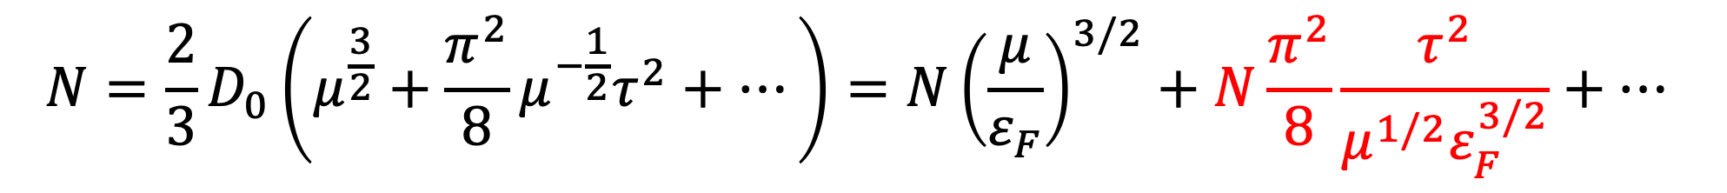

$$N=\frac{2}{3}D_{0}\left(μ^{\frac{3}{2}}+\frac{π^{2}}{8}μ^{−\frac{1}{2}}τ^{2}+…\right)=N{\left(\frac{μ}{ε_{F}}\right)}^{3/2}+N\frac{π^{2}}{8}\frac{τ^{2}}{μ^{1/2}ε_{F}^{3/2}}+…$$
$$≈N\frac{π^{2}}{8}\frac{τ^{2}}{{μ(0)}^{1/2}ε_{F}^{3/2}}=N\frac{π^{2}}{8}\frac{τ^{2}}{ε_{F}^{1/2}ε_{F}^{3/2}}=N\frac{π^{2}}{8}\frac{τ^{2}}{ε_{F}^{2}}$$
$$\frac{μ}{ε_{F}}≈1−\frac{π^{2}}{12}{\left(\frac{τ}{ε_{F}}\right)}^{2}+…$$

Slide 29
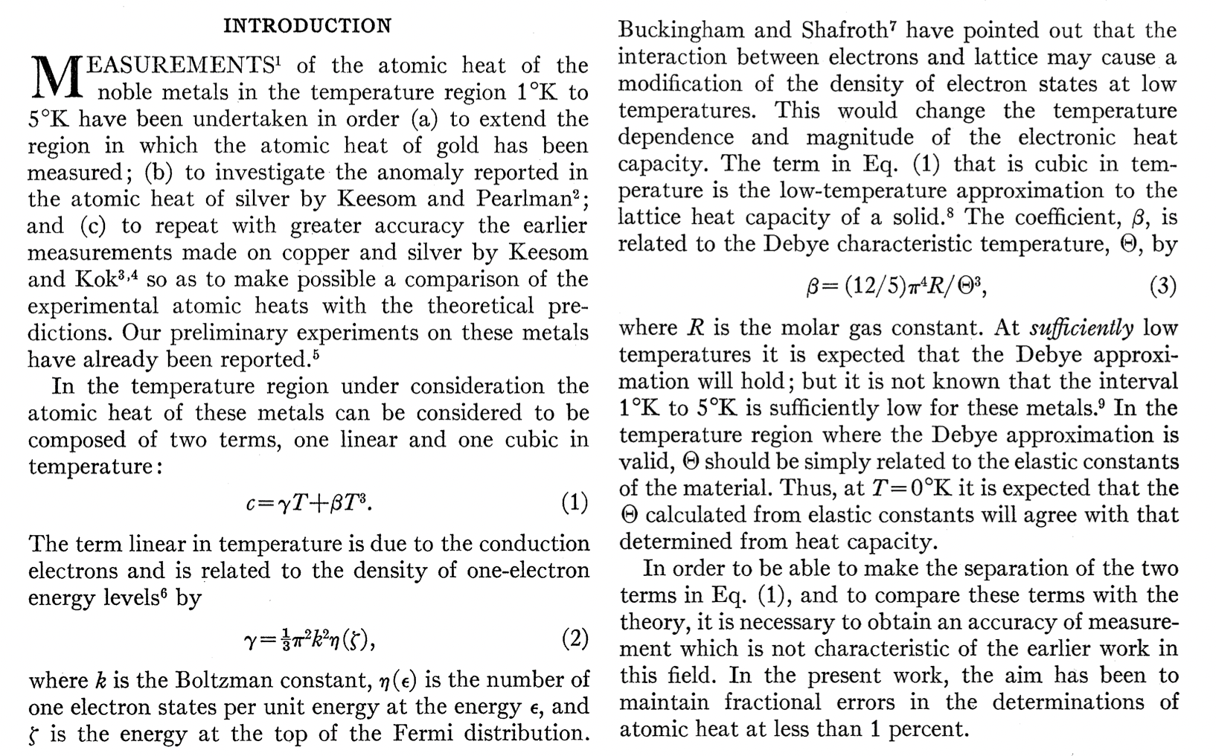
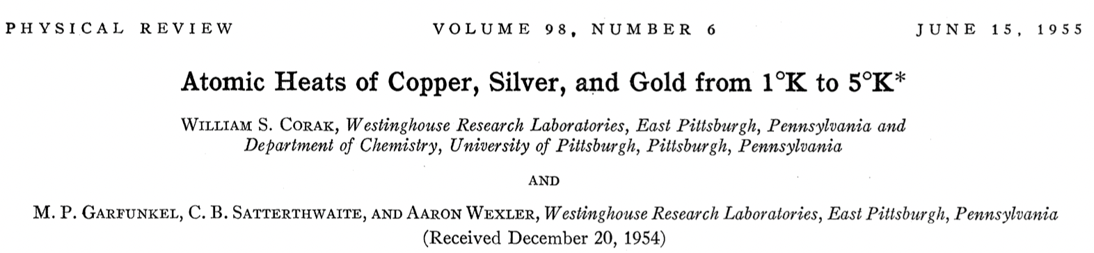
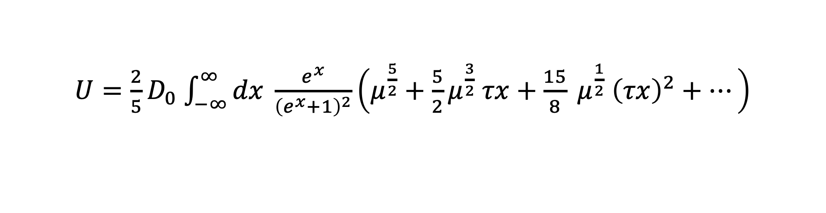
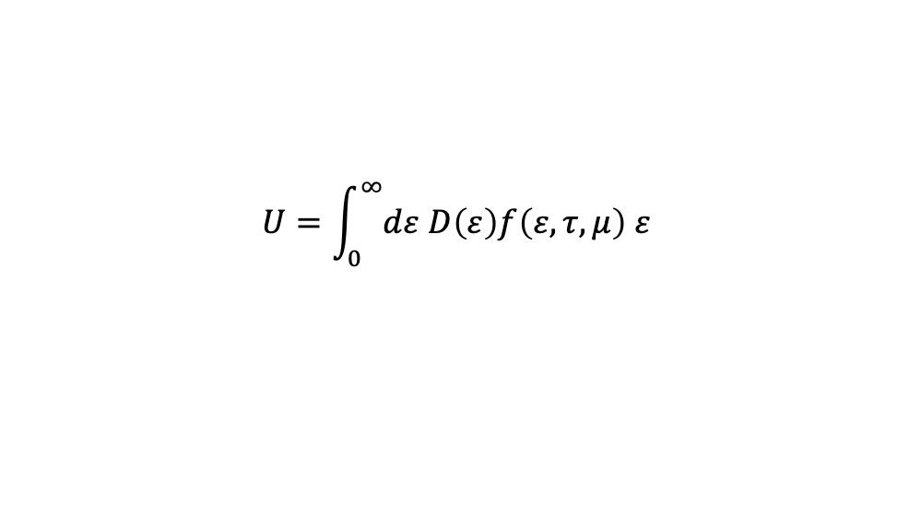

$$U=\int_{0}^{∞}{dε D\left(ε\right)f\left(ε,τ,μ\right) ε}$$
$U=\frac{2}{5}D_{0}$ $\int_{−∞}^{∞}{dx \frac{e^{x}}{{\left(e^{x}+1\right)}^{2}}\left(μ^{\frac{5}{2}}+\frac{5}{2}μ^{\frac{3}{2}} τx+\frac{15}{8} μ^{\frac{1}{2}} {\left(τx\right)}^{2}+…\right)}$
$$U=\frac{2}{5}D_{0}\left(μ^{\frac{5}{2}}+\frac{{5 π}^{2}}{8}μ^{\frac{1}{2}}τ^{2}+…\right)=\frac{3}{5}N\frac{μ^{5/2}}{ε_{F}^{3/2}}+N\frac{{2 π}^{2}}{8}\frac{τ^{2}}{μ^{−1/2}ε_{F}^{3/2}}+…$$
$=$ $\frac{3}{5}Nε_{F}+\frac{π^{2}}{4}\frac{τ^{2}}{ε_{F}}+…$

Slide 30



Case-II: $τ$
$$N=\int_{0}^{∞}{dε D\left(ε\right)f(ε,τ,μ)}=\frac{2}{3}N\int_{0}^{∞}{dε \frac{\sqrt{ε}}{ε_{F}^{3/2}} \frac{1}{e^{(ε−μ)/τ}+1}}$$
Normalize temperature and chemical potential by fermi energy
$$\overline{τ}=\frac{τ}{ε_{F}};\overline{μ}=\frac{μ}{ε_{F}};\overline{ε}=\frac{ε}{ε_{F}}$$
We get the following equation
$$1=\int_{0}^{∞}{\frac{3}{2} \sqrt{\overline{ε}}\frac{1}{e^{(\overline{ε}−\overline{μ})/\overline{τ}}+1}d\overline{ε}}$$
$$\overline{μ}(\overline{τ})$$

Slide 31


$Dot: 1=\int_{0}^{∞}{\frac{3}{2} \sqrt{\overline{ε}}\frac{1}{e^{(\overline{ε}−\overline{μ})/\overline{τ}}+1}d\overline{ε}}$
Red line: $1=\int_{0}^{∞}{\frac{3}{2} \sqrt{\overline{ε}}\frac{1}{e^{(\overline{ε}−\overline{μ})/\overline{τ}}}d\overline{ε}}$
Blue line: $1−\frac{π^{2}}{12}{\left(\frac{τ}{ε_{F}}\right)}^{2}$

Slide 32
Grand canonical potential
$$Ω=−τ\sum_{i}{\log\left[1+λe^{−ε_{i}/τ}\right]}$$

Slide 33




$$−\frac{1}{τ}Ω=\left(2s+1\right)\frac{V}{{\left(2π\right)}^{3}}4π\int_{0}^{∞}{dk}k^{2}log\left(1+λe^{−\frac{ℏ^{2}k^{2}}{2mτ}}\right)$$
$$\frac{ℏ^{2}k^{2}}{2mτ}=x^{2}$$
$$\frac{2s+1}{d^{3}}\frac{4V}{\sqrt{π}}\int_{0}^{∞}{dx}x^{2}log\left(1+λe^{−x^{2}}\right)$$
$$d=\sqrt{\frac{2πℏ^{2}}{mτ}}=\frac{1}{\sqrt[3]{n_{Q}}}$$

Slide 34




$$\frac{2s+1}{d^{3}}\frac{4V}{\sqrt{π}}\int_{0}^{∞}{dx}x^{2}log\left(1+λe^{−x^{2}}\right)$$
Taylor expansion of the logarithm
$f_{5/2}\left(λ\right)=\sum_{n=1}^{∞}{{(−1)}^{n+1}\frac{λ^{n}}{n^{5/2}}}$
$$Ω\left(τ,V,μ\right)=−τ\frac{2s+1}{d^{3}}Vf_{5/2}\left(λ\right)$$

Slide 35



$$N=−\frac{∂Ω}{∂μ}=−\frac{∂λ}{∂μ}\frac{∂Ω}{∂λ}=\frac{2s+1}{d^{3}}Vf_{3/2}(λ)$$
$$p=−\frac{∂Ω}{∂V}=τ\frac{2s+1}{d^{3}}f_{5/2}(λ)$$
$$p=\frac{2}{3} \frac{U}{V}$$
试着证明
$$U=\left(\frac{μ}{β}\frac{∂}{∂ μ}−\frac{∂}{∂ β}\right)\log{𝒵}$$

Slide 36






Equation of State
Pressure
$$p=−{\left(\frac{∂U}{∂V}\right)}_{σ}=−\sum_{i}{\frac{∂ε_{i}}{∂V} n_{i}}$$
The entropy depends on the number of accessible microstates, the populations n are constant at constant entropy
Recall that, for particles bounded in a box, the single-particle energy levels are related to the volume by
$$ε_{i}∝V^{−2/3}$$
Hence,
$$\frac{dε_{i}}{ε_{i}}=−\frac{2}{3}\frac{dV}{V}$$
$=\frac{2}{3}($ $\frac{3}{5}Nε_{F}+\frac{π^{2}}{4}\frac{τ^{2}}{ε_{F}}) for low τ$
$$p=−\sum_{i}{n_{i}\left(−\frac{2}{3} \frac{ε_{i}}{V}\right)}=\frac{2}{3} \frac{U}{V}$$
$$pV=\frac{2}{3} U$$
$$=Nτ for high τ$$

Slide 37



孔老师给的一个题目
$$Ω={∓g}_{s}\frac{V}{{\left(2π\right)}^{3}}4π\int_{0}^{∞}{dk}k^{2}log\left(1±e^{\frac{μ}{τ}}e^{−\frac{βk^{α}}{τ}}\right)$$
$$P=−\frac{∂Ω}{∂V}$$
$$U=\left(μτ\frac{∂}{∂ μ}+τ^{2}\frac{∂}{∂ τ}\right)\log{𝒵}$$

Slide 38


色散关系实际上就是能量-动量之间的关系
态密度（留意前面的第二种打开方式）
$$?D\left(ε\right)=\frac{dN}{dε}=\frac{V}{2π^{2}}{\left(\frac{2m}{ℏ^{2}}\right)}^{3/2}\sqrt{ε}=\frac{3}{2}\frac{N}{ε_{F}^{3/2}}\sqrt{ε}$$

